Slide 1
Blended Learning in the Competency Based Classroom
Jimmy Wood Ed.S.
Luella Elementary School

Slide 2
What is Blended Learning?
High quality blended learning combines the best of face-to-face instruction with the best of what we know about how to provide
learning online.
Blended learning is any formal education program in which a student learns at least in part through online learning, with some element of student control over time, place, path, or pace.
Students learn at least in part in a supervised brick-and mortar location away from home.
The modalities along each student’s learning path within a course or subject are connected to provide an integrated learning experience.

Slide 3
Blended Learning isn’t…
… just getting every student a laptop or device.
… just using a Google document for a class assignment.
… just having access to some digital content for a special assignment.
Blended learning integrates the learning experiences both online and face-to-face to provide a seamless shift in the instructional model that increases student control of time, place, path, and/or place.
Blended learning empowers teachers by technology to do what they do best-provide differentiated small group or one-on-one instruction, have caring and meaningful interactions with students, assess student learning each step of the way, and intervene to problem-solve and coach students to success.
Blended learning offers a vehicle for optimizing the instructional design toward personalization through transparent data dashboards and enhancing a student’s choice of path.

Slide 4
Student Agency
Agency - noun agen·cy \ˈā-jən(t)-sē\ - the satisfying power to take meaningful action and see the results of our decisions and choices.
Blended learning allows every student to engage in a learning experience tailored to his or her individual:
Needs
Strengths
Interests / Motivations

Slide 5
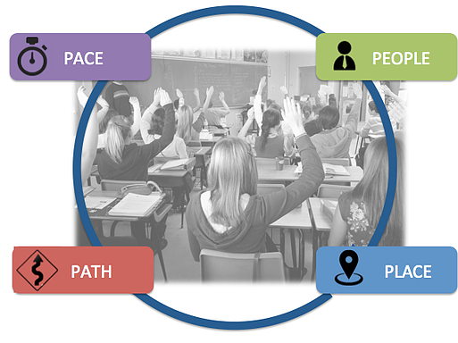
Student Agency Cont.
Blended learning experiences are personalized by
providing students voice and choice in the key dimensions
of their learning experience:
Pace - Students progress through the curriculum at the rate they master material.
Path - Students engage in learning activities that meet their individual needs and align with their interests.
Place - Students have access to multiple learning environments and formats.
People - Students access a variety of teachers, peers, and others for individualized support.

Slide 6
Teacher Agency
Agency - noun agen·cy \ˈā-jən(t)-sē\ - the satisfying power to take meaningful action and see the results of our decisions and choices.

Slide 7
Blended Learning vs. Technology Integration

Slide 8
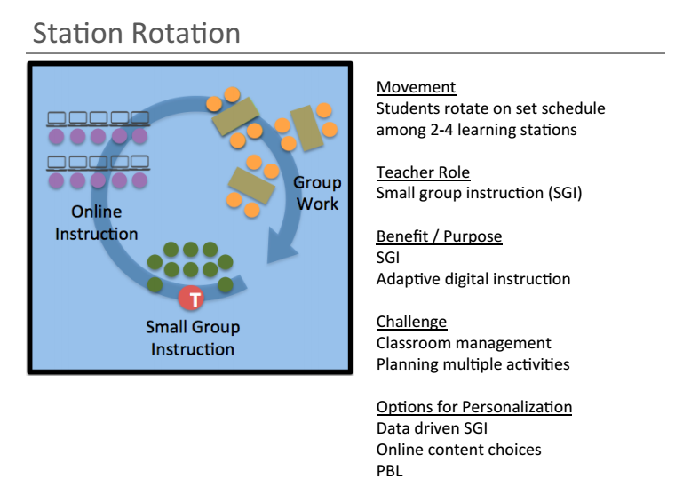

Slide 9
Station rotation doesn’t mean a student has to move through each station.
Do you…
…visit a podiatrist, dentist, and cardiologist prior to visiting an ophthalmologist when your primary care physician has already assessed you and determined you’re in perfect health other than having slight vision problems?
Blended classrooms are balanced.
Online Instruction
Small Group Instruction
Group Work
Technology Enabled
Direct Instruction

Slide 10
Competency-Based and Blended Learning
Why Should a Competency-Based School Blend its Learning?
Boosting Skills
On-Demand Learning and Assessments
Advanced Students
How does Blended Learning fit into Competency-Based Learning
Stations can be used to introduce/teach competencies
Stations can be used to demonstrate mastery of competencies

